Slide 1

UNIT 5B
DO YOU WANT TO LISTEN TO MUSIC?
(QUESTION MODEL 1.3)

Slide 2

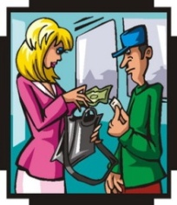
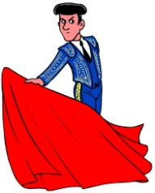

















VOCABULARY – TRANSITIVE VERBS
TO SUBMIT | TO COVER | TO UNDERSTAND | TO COLOR
TO KISS | TO OBSERVE | TO KNOW | TO DRAW
TO CONDUCT | TO GIVE | TO LISTEN TO | TO WATCH
TO STORE | TO HOLD | TO MAKE | TO PASS
TO TOUCH | TO SHOW | TO DO | TO FAIL

Slide 3
VOCABULARY - PICTURES

Slide 4
VOCABULARY - LISTENING

Slide 5
MODEL FORMING
QUESTION MODEL 1.3
DO YOU WANT TO LISTEN TO MUSIC?
YES, I WANT TO LISTEN TO MUSIC.
NO, I DON’T WANT TO LISTEN TO MUSIC.
NOTE: We can replace “want” with “like”, “need”, “have”.

Slide 6
QUICK REACTION PRACTICE
Want to …/ Like to …
listen to | music, the radio
draw | flowers, animals
watch | a movie, a play
make | cakes, toys
show | your photos, your videos
conduct | music, a class
observe | the stars, the moon
have | a bicycle, a car
pass | the TOEIC, the TOEFL
turn on | the fan, the light
smoke | a cigar, a cigarette
play | the guitar, the piano
Have to … / Need to …
store | meat, rice
submit | homework, a report
do | the housework, homework
review | the vowels, the consonants
cook | lunch, dinner
clean | the floor, the fan
wash | the windows, the dishes
feed | the cat, the dog
put on | a scarf, gloves
cover | the book, the notebook
understand | grammar, vocabulary
carry | a bag, a map

Slide 7
HOMEWORK
Write 20 questions and answers using Question Model 1.3

